Slide 1


, , , and what we can do with them
Claire Boyd
Data Scientist
NYC Department of Finance, Property Modeling & Valuation
boydclaire@finance.nyc.gov

Slide 2


A little about me
Native New Yorker
Researcher at Urban Institute
Studied Computer Science and Public Policy at UChicago
Worked at Cook County Assessors Office and Mansueto Institute for Urban Innovation, applying data science in the property assessment space
Now at DOF - excited about using and building open-source tools to enhance the work we do for the City of New York

Slide 3
Imagine this.

Slide 4
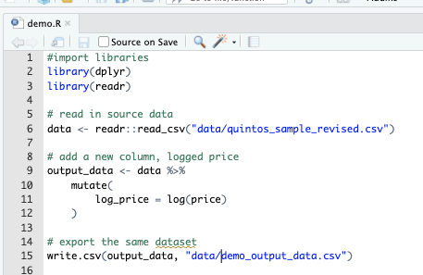
My coworker Ethan and I are tasked to work on a project demo.R. The goal is to add a few more columns to an existing csv (logged price, logged estimate, price-estimate, log_price-log_estimate).
In the current ecosystem:
How could I work on this task so that my work was version controlled (saved regularly and sequentially)?
How could I collaborate with Ethan on this in real time?
How could we combine our work when it was finished, assuming someone else might want to repeat this process another time?
Where would we store the finished product so that our team knew it was the final version and future data analysts might be able to replicate our work easily?

Slide 5
My coworker Ethan and I are tasked to work on a project demo.R. The goal is to add a few more columns to an existing csv (logged price, logged estimate, price-estimate, log_price-log_estimate).
In the current ecosystem:
How could I work on this task so that my work was version controlled (saved regularly and sequentially)?
How could I collaborate with Ethan on this in real time?
How could we combine our work when it was finished, assuming someone else might want to repeat this process another time?
Where would we store the finished product so that our team knew it was the final version and future data analysts might be able to replicate our work easily?
Current system | Problems or potential risks
Save different named versions of the same script | Which version is the most up to date? How do we revert changes of scripts if we make a mistake?
Work on different scripts and talk to each other | Relies on really good communication to work seamlessly Repetitive work – could do the same portion of the project without realizing it
Copy and paste | Different changes to the same code – how to reconcile? Potential for repetitive code and take additional time to make sure it can run seamlessly
Agency-Specific Secure Network Drive | Should we have a new 2025 folder? Where should it live in the G:/ Drive? Would a new hire easily know where to look for this information?

Slide 6
Enter & .

Slide 7
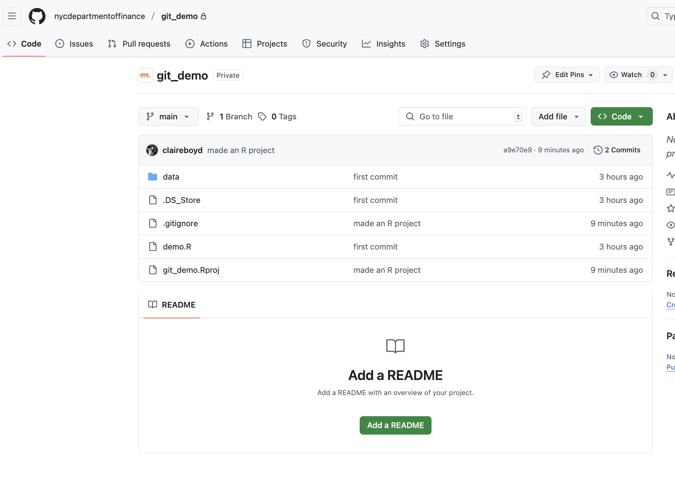
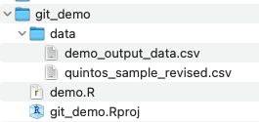
GitHub
GitHub is a website that hosts repositories (folders) under version control by git. It is the remote (cloud) storage for repositories (folders) that allows us to work together on the same material.
Local Machine
git
git is a version control system (a mini programming language) that keeps track of all changes made in a folder (repository/repo)

Slide 8
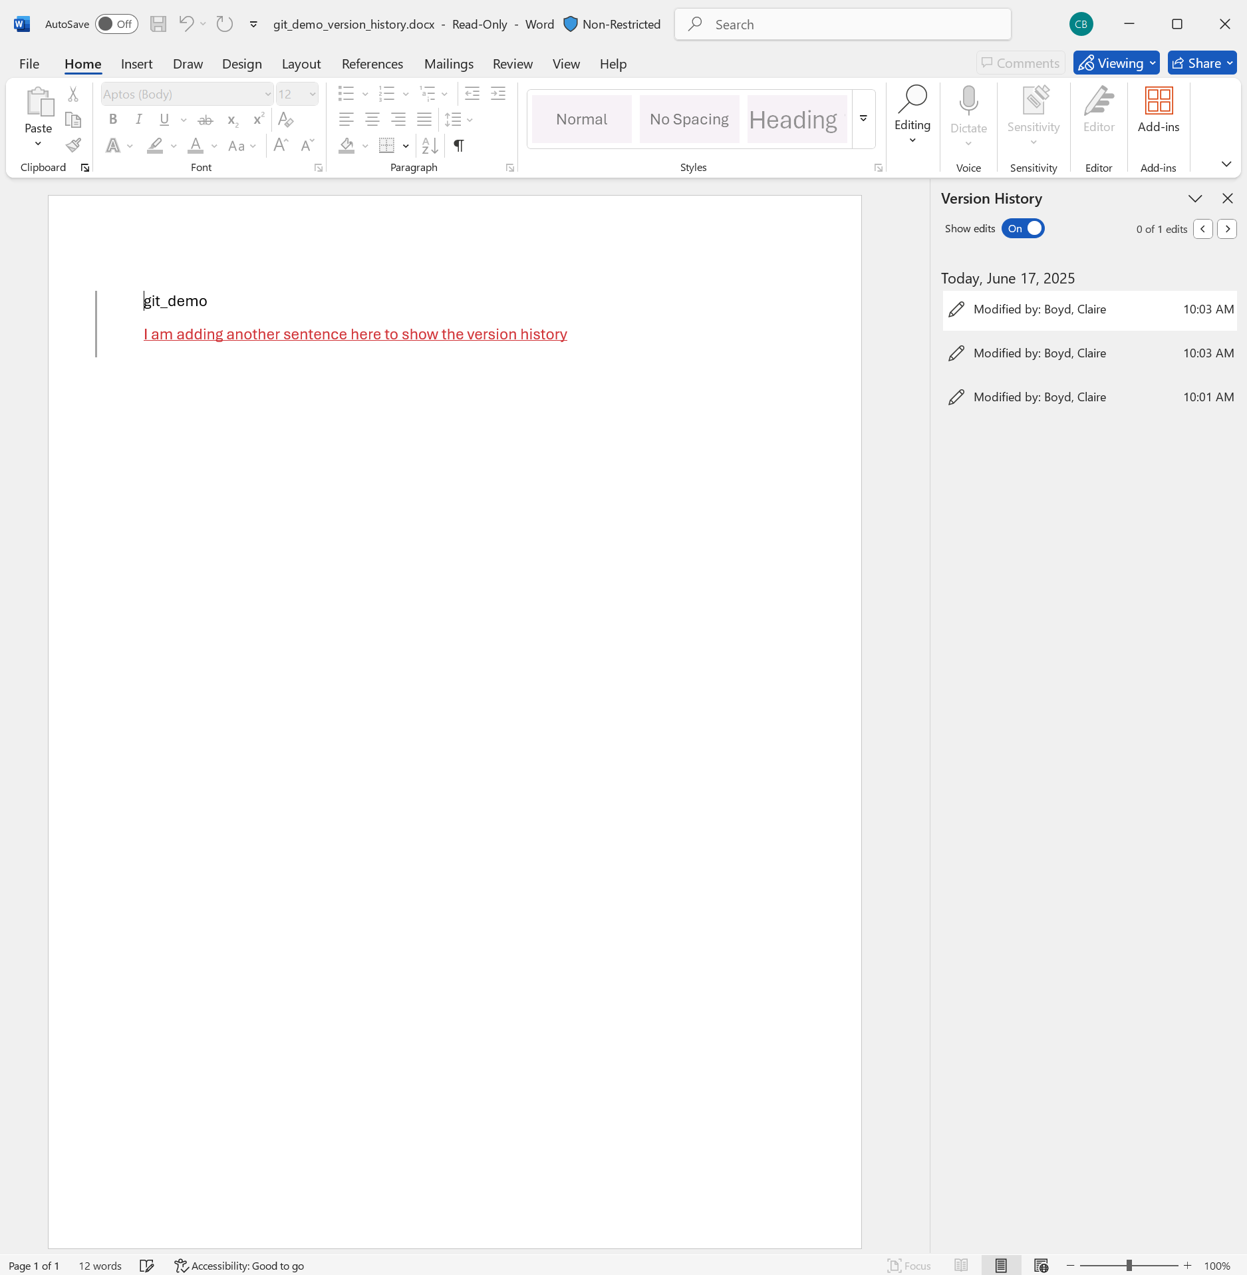
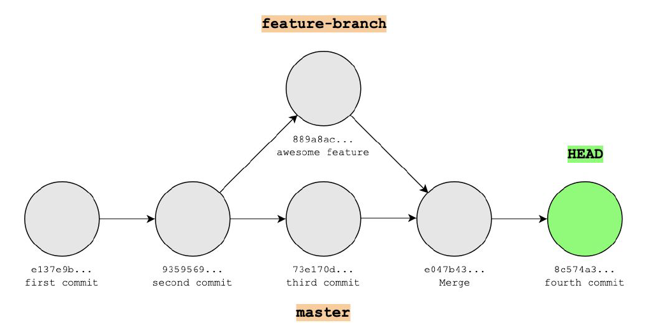
git
git is like Word’s Version History for code.
It is a version control system that keeps track of all changes made in a folder (repository/repo)
A historical backup of “snapshots” of your work
Think of it as a “Save As” version
git can track branches, or different versions of the same folder locally, so you can try out two different things at one (e.g. master vs. feature-branch)
It is natively a command line interface (CLI) tool
git saves a stream of snapshots (called commits)

Slide 9
git
git is like Word’s Version History for code.
It is a version control system that keeps track of all changes made in a folder (repository/repo)
A historical backup of “snapshots” of your work
Think of it as a “Save As” version
git (on it’s own) only keeps track of work on your local machine
git saves a stream of snapshots (called commits)

Slide 10
My coworker Ethan and I are tasked to work on a project demo.R. The goal is to add a few more columns to an existing csv (logged price, logged estimate, price-estimate, log_price-log_estimate).
In the current ecosystem:
How could I work on this task so that my work was version controlled (saved regularly and sequentially)?
How could I collaborate with Ethan on this in real time?
How could we combine our work when it was finished, assuming someone else might want to repeat this process another time?
Where would we store the finished product so that our team knew it was the final version and future data analysts might be able to replicate our work easily?

Slide 11
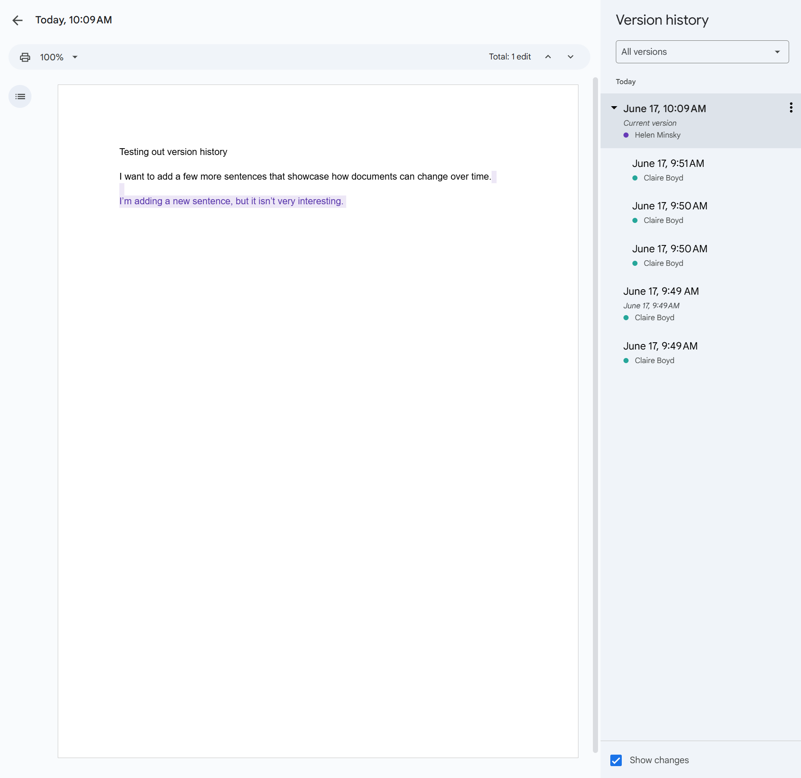
GitHub
When you use git/GitHub together, it is like GoogleDocs for code.
GitHub is a website that hosts repositories (folders) under version control by git.
It is the remote (cloud) storage for repositories (folders) that allows us to work together on the same material.
It allows for team development
Different versions of the project (these “snapshots”) can be merged together to create one final version
Allows for simultaneous work

Slide 12
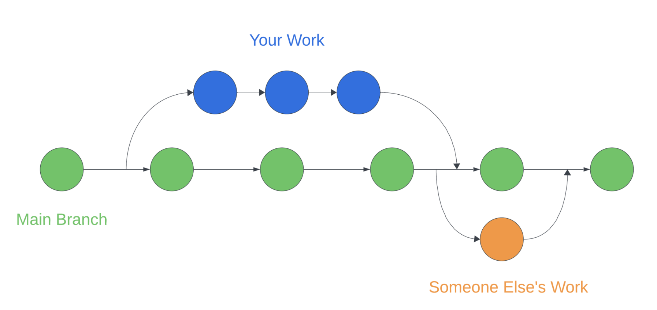
GitHub
Working alone
When you use git/GitHub together, it is like GoogleDocs for code.
GitHub is a website that hosts repositories (folders) under version control by git.
It is the remote (cloud) storage for repositories (folders) that allows us to work together on the same material.
It allows for team development
Different versions of the project (these “snapshots”) can be merged together to create one final version
Allows for simultaneous work
Collaborating with others

Slide 13
90% of Fortune 500 Companies use GitHub
GitHub is used by over 4 million organizations, and more than 100 million developers
1.5% percent of internet users use GitHub
In 2022, there were 3.5 billion contributions to GitHub projects, 20% were made to public repositories (project folders) the rest to private repositories.
Using this tool is industry standard for all data science and software teams.

Slide 14
My coworker Ethan and I are tasked to work on a project demo.R. The goal is to add a few more columns to an existing csv (logged price, logged estimate, price-estimate, log_price-log_estimate).
In the current ecosystem:
How could I work on this task so that my work was version controlled (saved regularly and sequentially)?
How could I collaborate with Ethan on this in real time?
How could we combine our work when it was finished, assuming someone else might want to repeat this process another time?
Where would we store the finished product so that our team knew it was the final version and future data analysts might be able to replicate our work easily?

Slide 15

Using GitHub @

Slide 16
If you use git/GitHub, you might already use it….
For code inspiration: Finding code (in a public repository or folder) that looks similar to what you want to do
To download and review documentation for open-source packages: guides for how to download a package and/or examples of how it works so that you can use it in your own code
To collaborate with other programmers on your team on a data analysis, data science or data engineering task
To build your own package to make common tasks within your team easy to replicate and standardize
….{many more examples…}

Slide 17
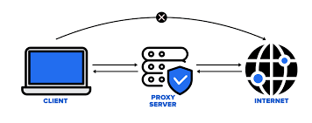
Why might you not already use git/GitHub?
If you use a city machine, it is likely that your internet connection is configured to operate through a proxy server for additional security.
Your browser and other core applications are already configured to reach the internet using the proxy server. Git (and IDEs like Rstudio and VSCode) is not automatically configured with these settings, so if you have tried to use it and gotten a HTTP Connection error this might have been why. We need to manually configure the settings to allow these applications to successfully access the internet.

Slide 18
Let’s try it.
Notes:
Share link to markdown file: https://github.com/nycdepartmentoffinance/onboarding/blob/main/github.md

Slide 19
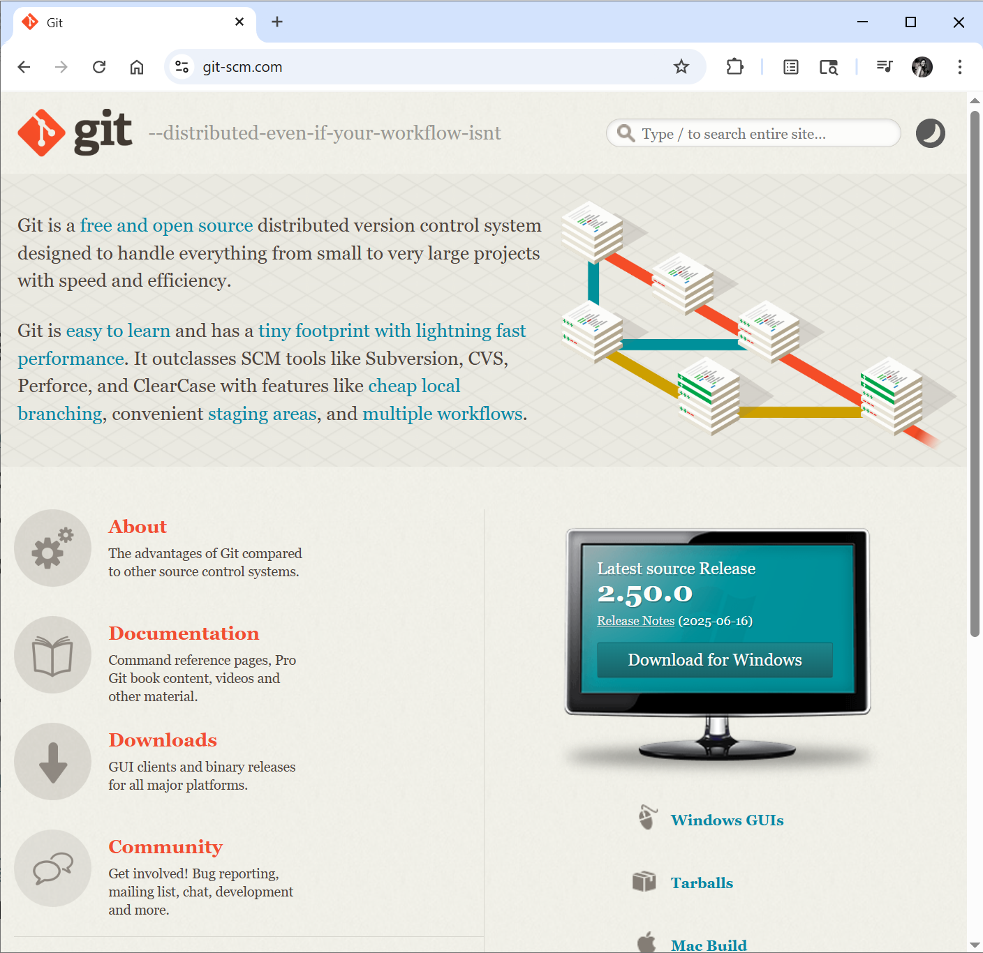
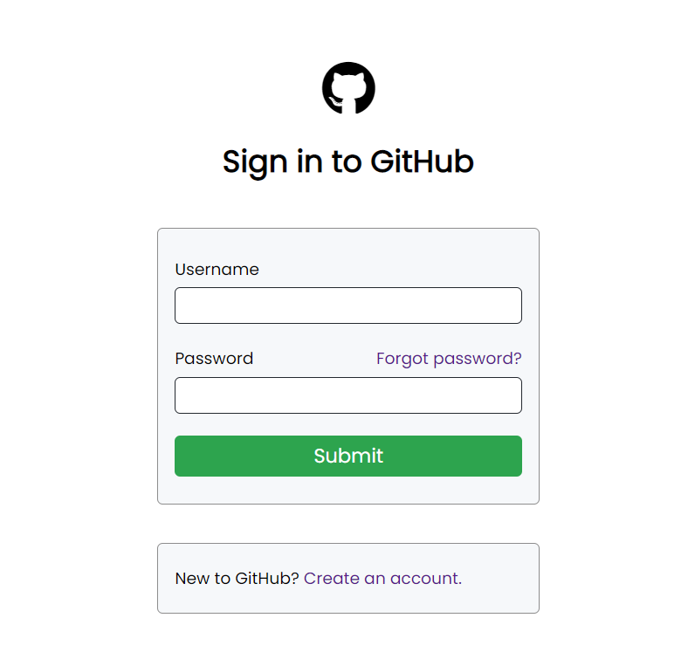
git/GitHub initial set-up
Install git (https://git-scm.com/) on your local machine
Create a free GitHub account (with your work email): https://github.com/

Slide 20
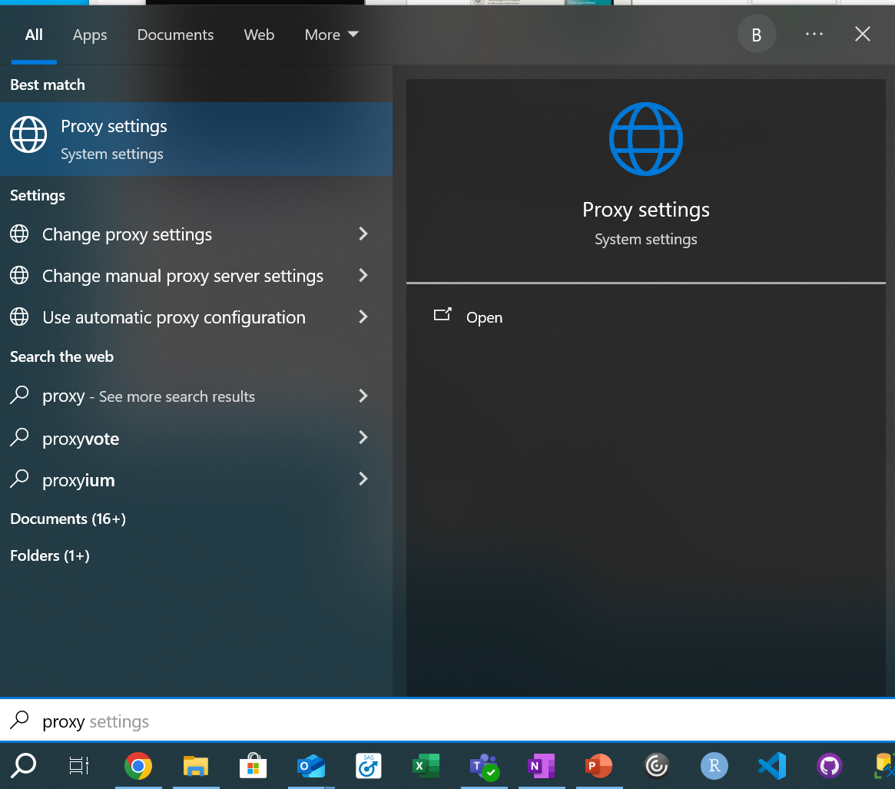
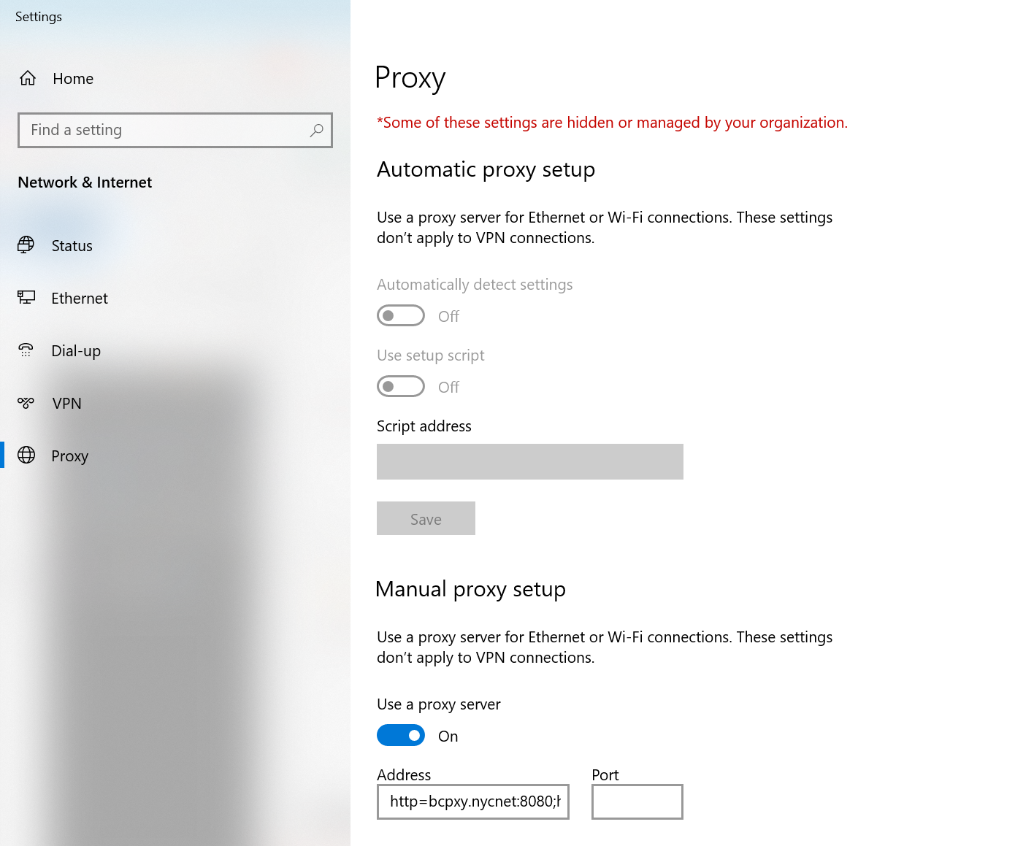
How do you configure git to connect through the proxy?
Step 1: Find proxy hostname // port

Slide 21
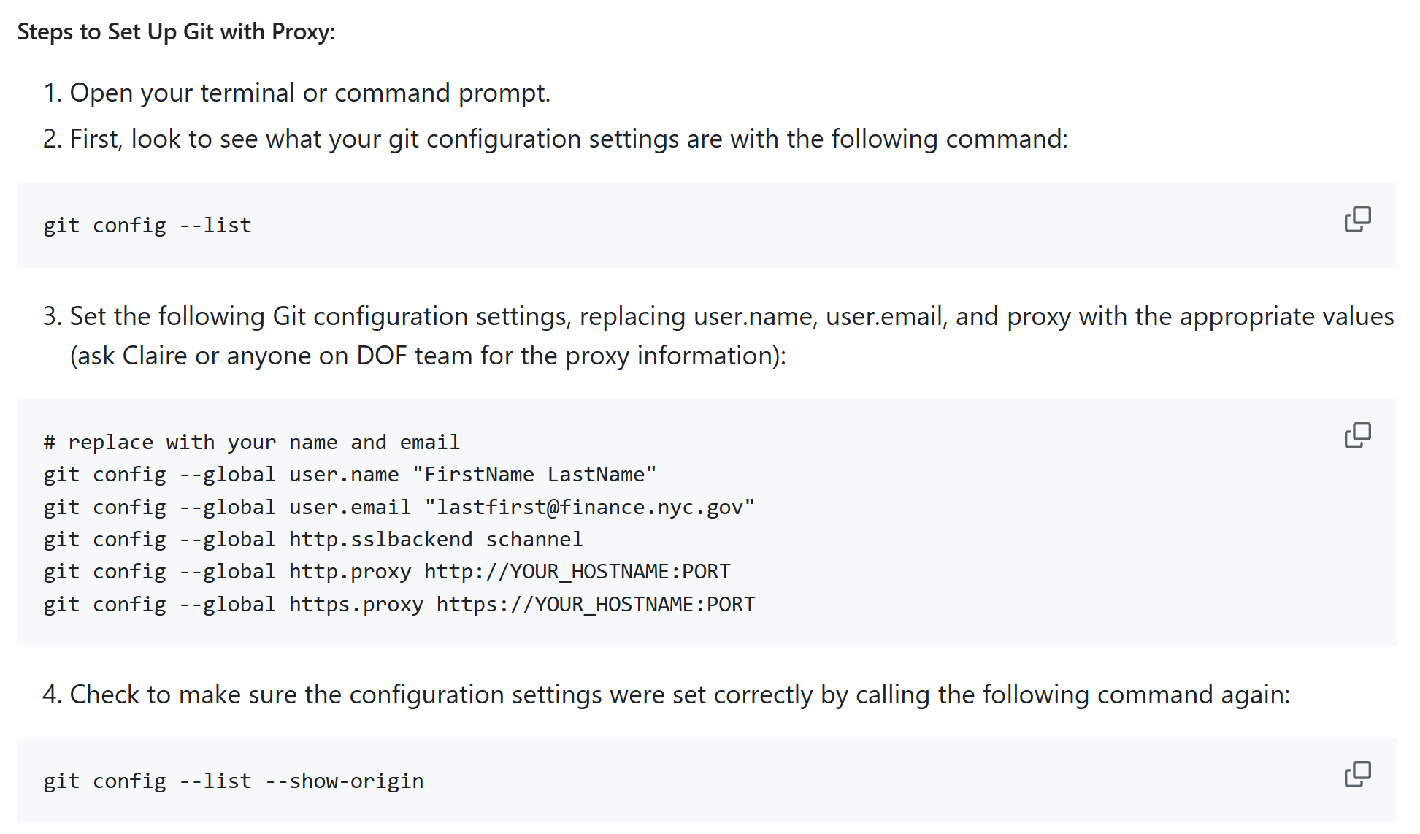
How do you configure git to connect through the proxy?
Step 2: Share this information with git.

Slide 22
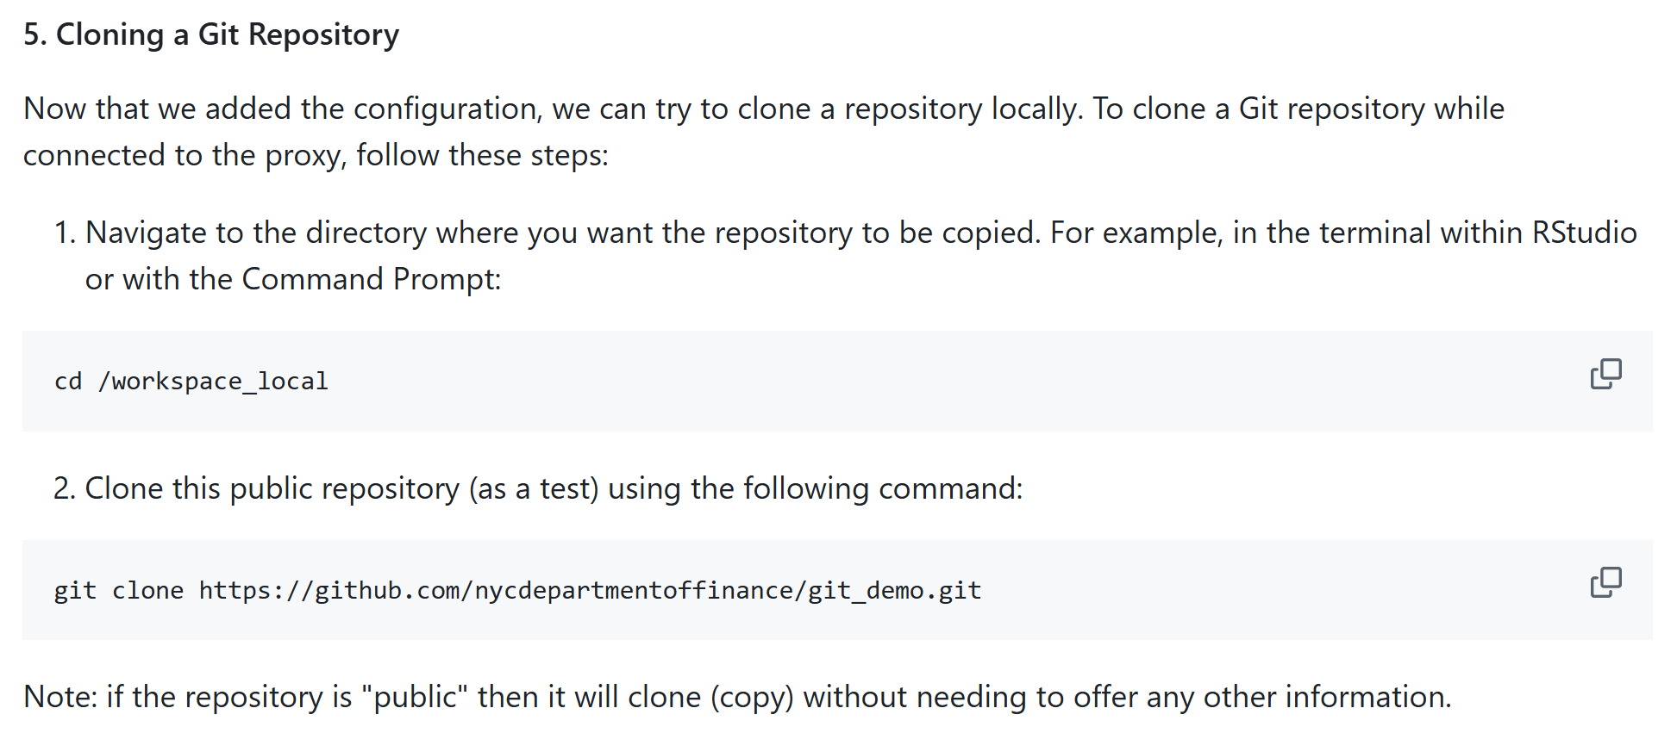
How do you configure git to connect through the proxy?
Step 3: Try cloning (copying) a remote repository from GitHub

Slide 23
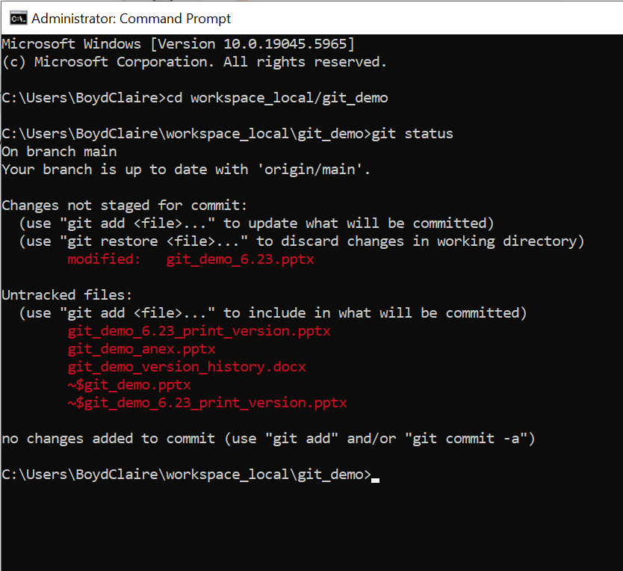
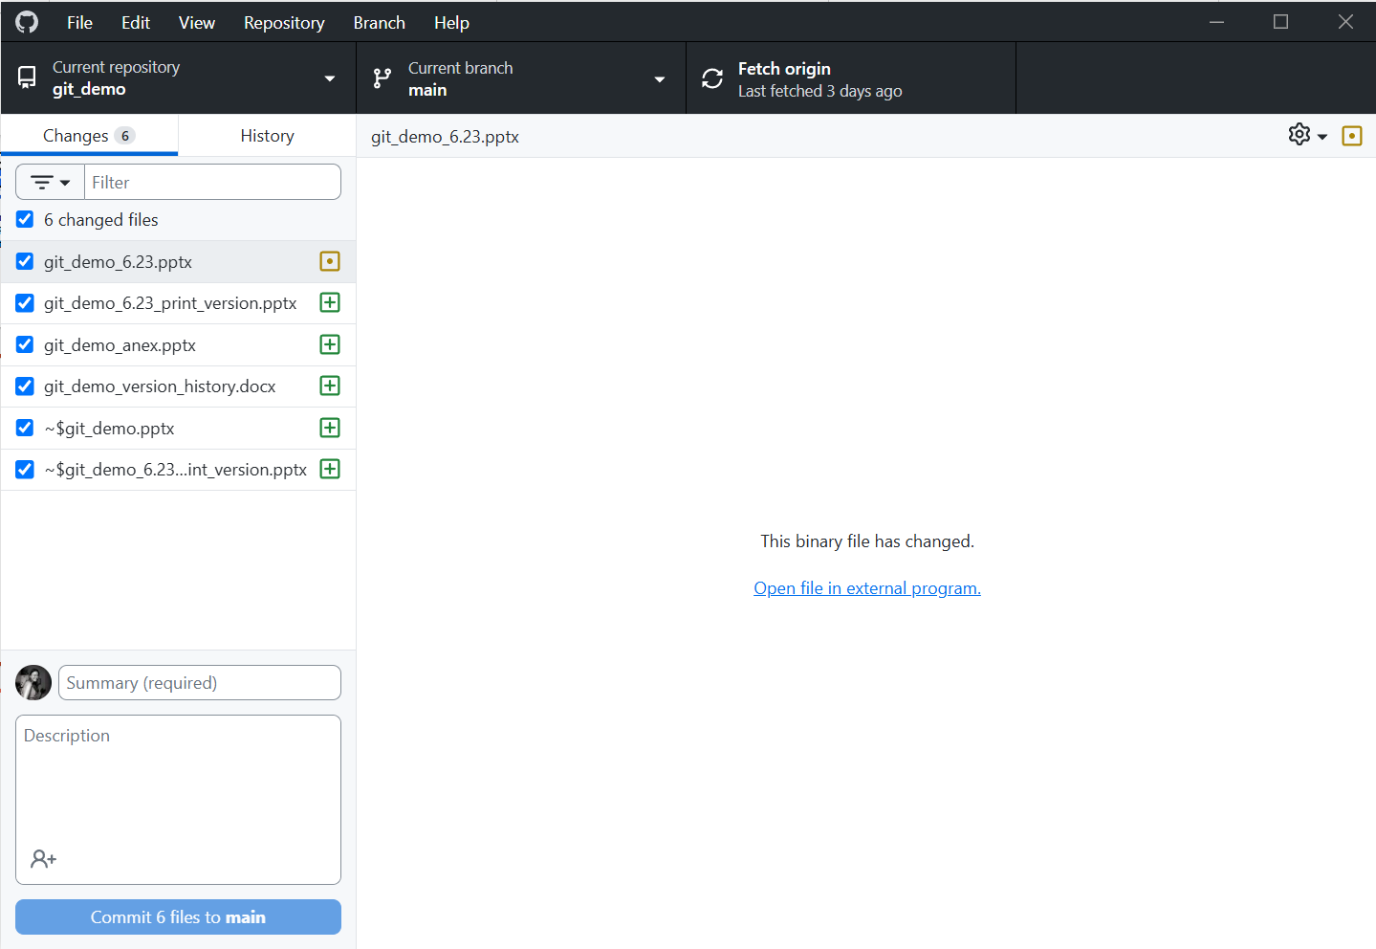
How can you use git?
Command line interface (CLI)
GitHub Desktop App
Notes:
Live demo if time allows

Slide 24
What can we use it for?

Slide 25
Existing use cases for GitHub at DOF
Benefits for data science teams:
Host internal/external documentation for onboarding materials
Create homes for all project related materials as the ground truth, where everyone can access/update them
Allow for easier code review and internal collaboration, to minimize reliance on institutional knowledge to repeat tasks
Create packages for internal use, to streamline data pipelines/repetitive tasks
Use git actions for additional compute power
Collaborate with other teams/organizations on projects
Benefits for other DOF teams:
Build and host interactive maps and dashboards to display information in an intuitive way, completely free
Use it as a project management tool to track progress on team goals/work
Walk through:
https://github.com/orgs/nycdepartmentoffinance/repositories

Slide 26
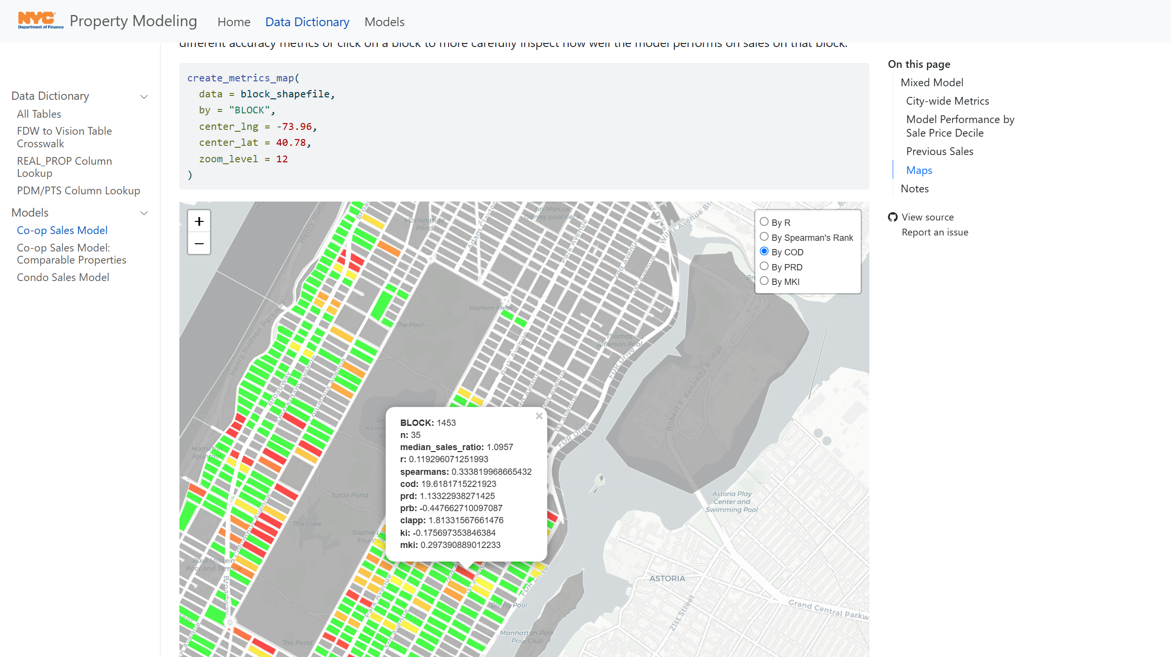
Existing use case #1: Free websites, hosting interactive maps
https://nycdepartmentoffinance.github.io/models/coop_sales_model.html#maps

Slide 27
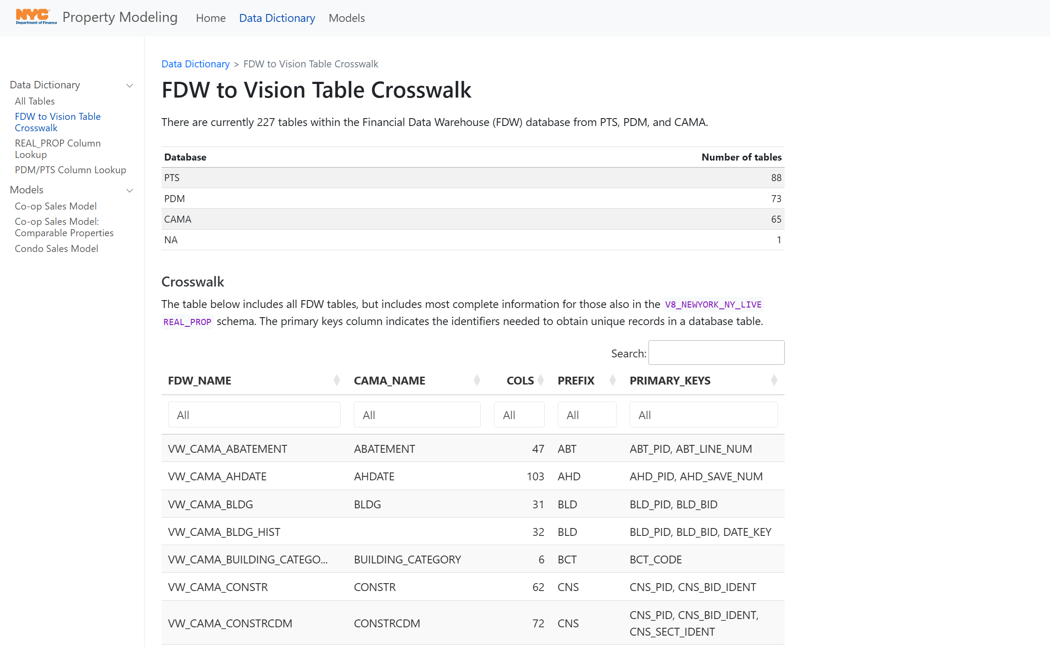
Existing use case #2: Interactive data dictionaries
https://nycdepartmentoffinance.github.io/data_dictionary/fdw_crosswalk.html

Slide 28
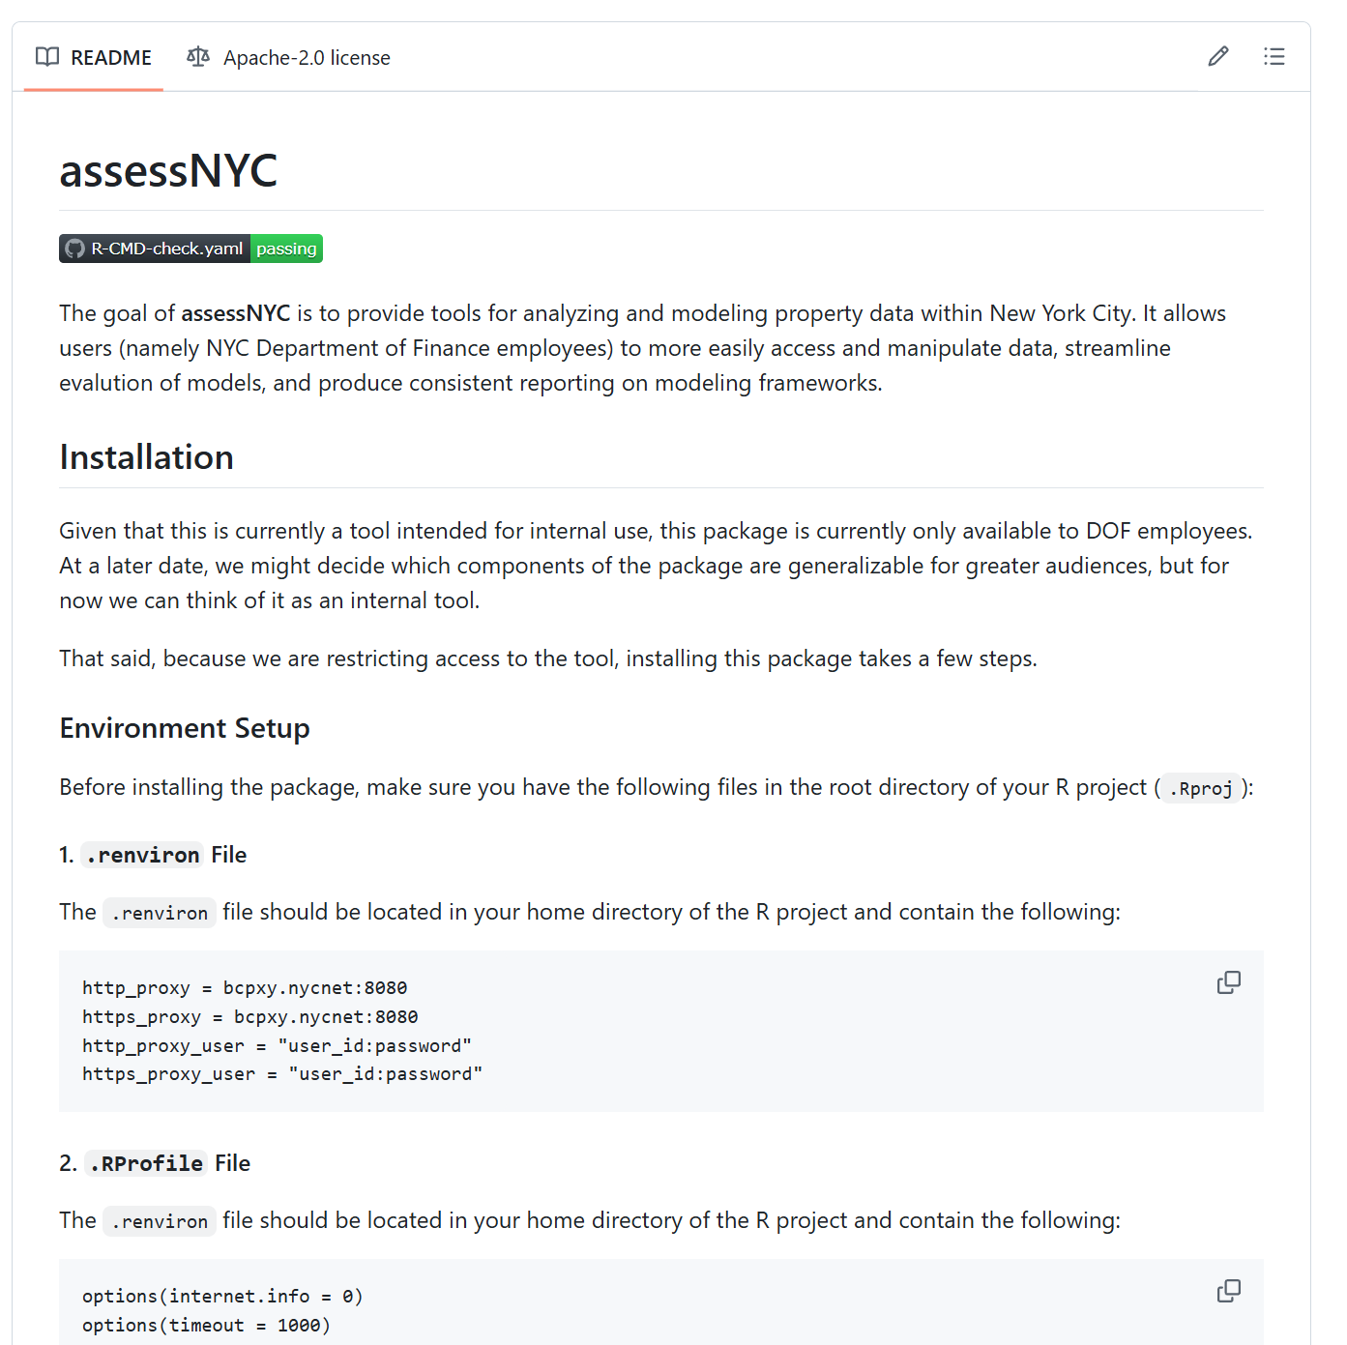
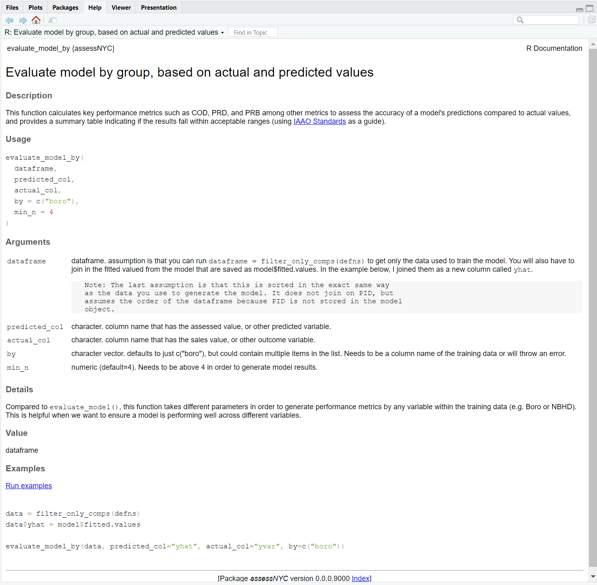
Existing use case #3: Internal packages for common tasks
assessNYC R package
evaluate_model_by() function within package
https://github.com/nycdepartmentoffinance/assessNYC

Slide 29
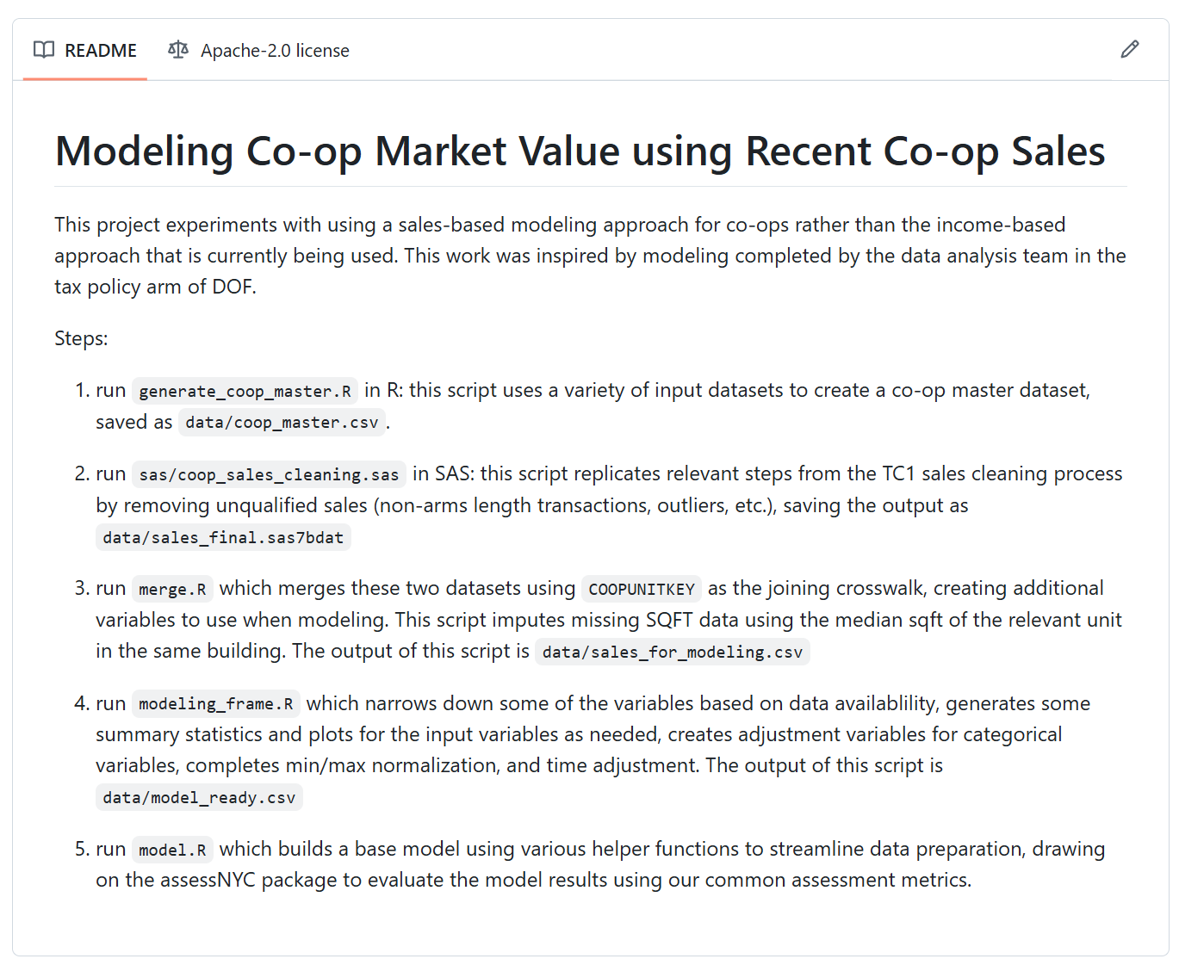
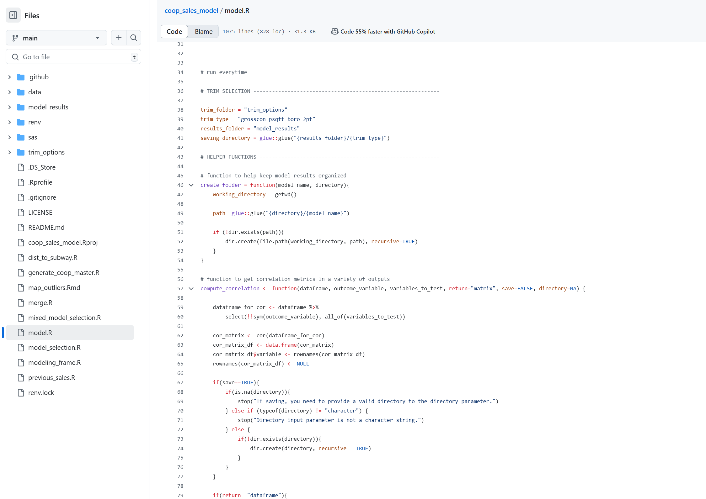
Existing use case #4: Documenting existing project work
Documentation
Code

Slide 30
Want to try it for yourself?

Slide 31
Opportunities to get started
Initial set-up
Download git
Create a free GitHub account
Download GitHub Desktop (if you prefer a point and click interface)
Explore the onboarding resources on our DOF GitHub organization:
Github set-up with proxy server
Proxy set-up for RStudio // VSCode
Database Connections in R // Python
Project set-up for R // Python using virtual environments (to track package uses/dependencies)
Create your own repository to start playing around with how it works.

Slide 32
Questions?

